Slide 1
Use ESP32s to Gather Real-Time Meteorological Data
Harnessing the power of ESP32 microcontrollers, we can build a robust system
to collect real-time meteorological data, providing valuable insights into the local climate and weather patterns.

Slide 2


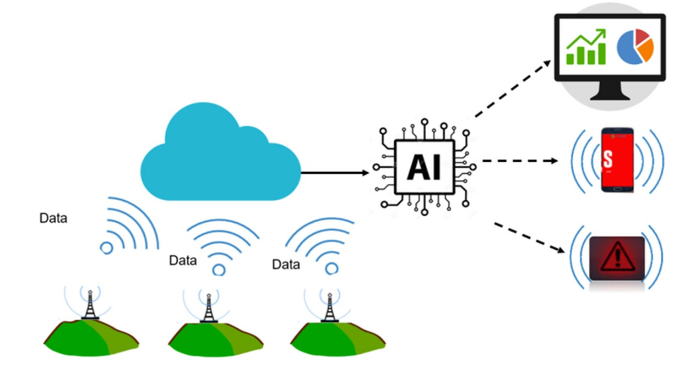


Objective
Proposed Solution:
Our solution incorporates a unique Multi-Layered Architecture: This layered approach allows us to tackle cloud burst prediction from both ground-level sensor data and high-altitude satellite observations.
Time Series Model:
Utilizes meteorological data from IMD and Open-Meteo API to analyze historical weather patterns for cloud burst prediction using advanced Time series algorithms like RNN & LSTM.
Real-Time Hardware Data Collection:
Integrates sensors (e.g., DHT22, BMP180) to collect environmental data, which is fed into the time series model for real-time analysis and prediction refinement.

Slide 3

Comprehensive Sensor Suite
Temperature and Humidity The DHT11 sensor accurately measures temperature and relative humidity, enabling comprehensive environmental monitoring.
Air Quality
The MQ135 air quality sensor tracks changes in air quality, which can indicate incoming weather patterns.
Precipitation
Rain sensor module provide valuable data on precipitation levels.

Slide 4




Reliable Data Transmission
ESP-NOW Protocol
Utilizing the ESP-NOW protocol, the system can reliably transmit data between ESP32 nodes without the need for a central Wi-Fi network.
Cloud Storage
The collected data is securely stored in the Firebase cloud platform, ensuring easy access and long-term retention.
Local Processing
On-board processing on the ESP32 microcontrollers allows for real-time analysis and decision-making at the edge.

Slide 5



Robust Power Supply
Continuous Operation
A reliable power supply, such as a
solar panel system and battery bank, ensures uninterrupted data collection and transmission.
Energy Efficiency
Careful power management strategies on the ESP32 microcontrollers optimize energy consumption, maximizing the system's runtime.
Resilience
The robust power supply maintains the
system's operation even during
periods of inclement weather or grid
outages.

Slide 6


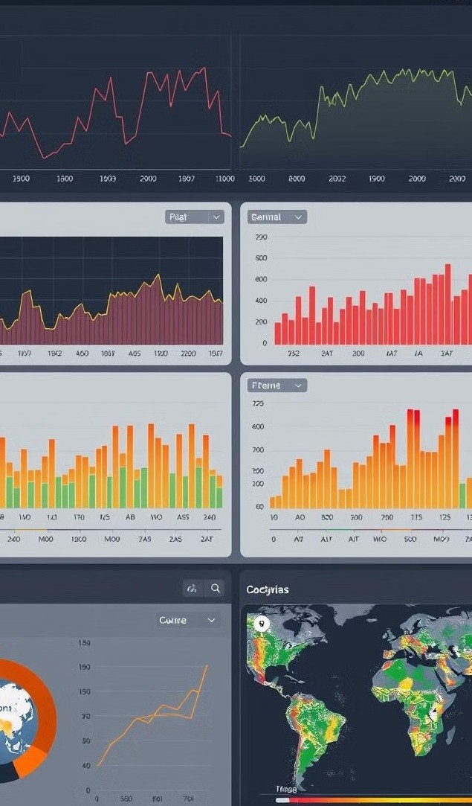

Data Visualization and Analy tics
1
Real-Time Monitoring
The web-based dashboard provides live updates on the collected meteorological data, enabling immediate insights and decision-making.
2
Historical Analysis
Comprehensive data logging in Firebase allows for in-depth analysis of trends and patterns over time.
3
Predictive Modeling
Advanced analytics can leverage the real-time and historical data to generate reliable weather forecasts and predictions.

Slide 7
Technical Approach

Slide 8

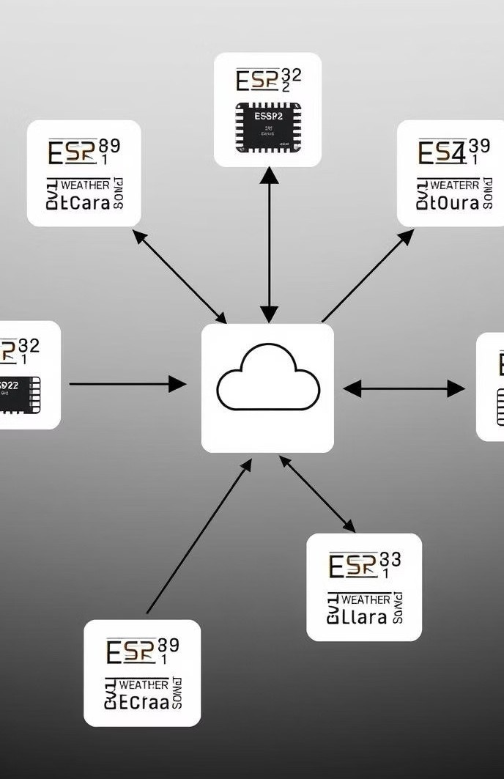

Scalable and Modular Design
Expandable Network
The modular architecture allows for easy expansion, enabling the deployment of multiple ESP32-based weather stations across a wide area.
1
Centralized Management
A central data hub coordinates the data collection, storage, and analysis, providing a unified view of the meteorological
information.
2
Cloud Integration
Seamless integration with cloud platforms, such as Firebase, ensures secure storage, remote access, and advanced data processing capabilities.
3

Slide 9

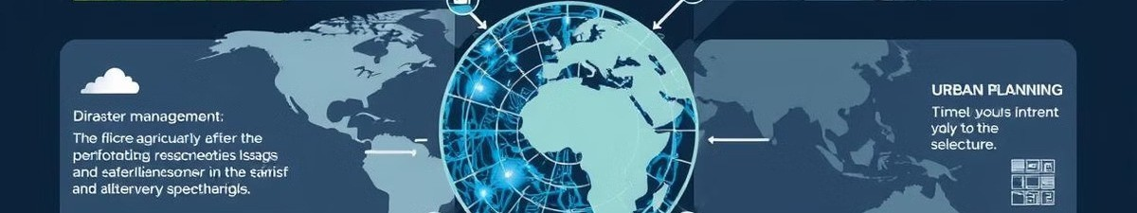



Innovative Applications
Precision Agriculture
Farmers can optimize irrigation,
pest control, and crop management based on the real-time weather
data.
Disaster Preparedness
Early warning systems can leverage the meteorological data to predict and mitigate natural disasters, such
as floods and storms.
Urban Planning
City planners can use the data to improve infrastructure, transportation, and public safety
initiatives based on weather patterns.
1
2
3

Slide 10
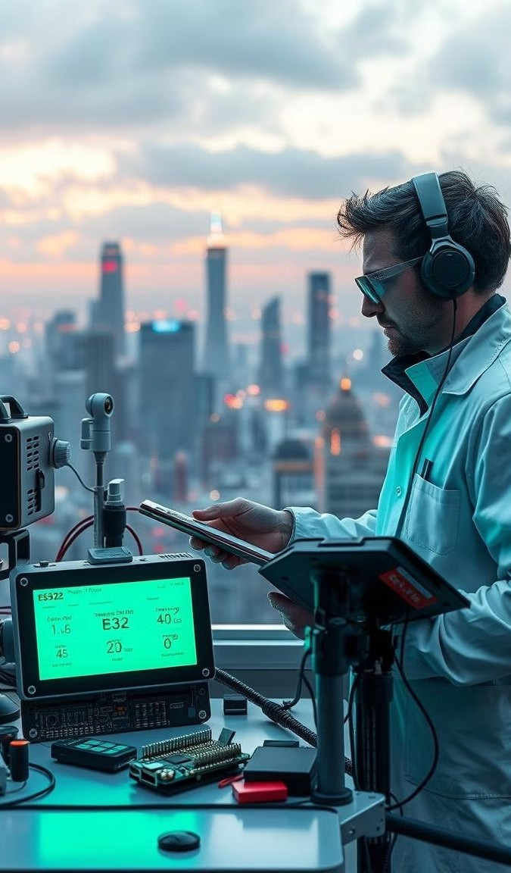
Conclusion and Future Considerations
This comprehensive system leverages the power of ESP32 microcontrollers, a diverse sensor suite, and robust data transmission to gather real-time meteorological data. The scalable and modular design, coupled with advanced data visualization and analytics, opens up a world of innovative applications in various industries.

